Slide 1
Office 365 Development

Slide 2

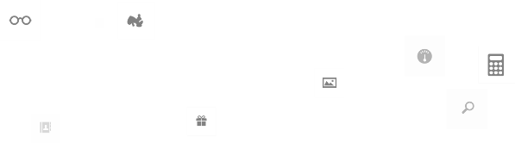
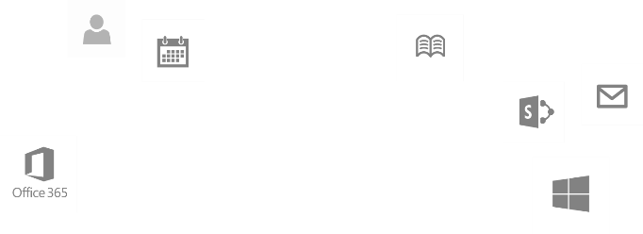
Recap
Introduction to Office 365 development
Module 1: Introduction to Office 365 development
Module 2: Getting started with Apps for Office
Module 3: Getting started with Apps for SharePoint
Module 4: Moving Full Trust Code to the Cloud Using Repeatable Patterns and Best Practices
Module 5: Getting started with the Office 365 APIs
dev.office.com/training

Slide 3
Course Agenda
Deep Dive into Integrating Office 365 APIs with Web Applications
Module 1: Deep Dive into Azure AD with the Office 365 APIs
Module 2: Deep Dive into Office 365 APIs for Calendar, Mail, and Contacts
Module 3: Deep Dive into Office 365 APIs for OneDrive for Business
Module 4: Deep Dive into Office 365 APIs for SharePoint Site services
Module 5: Deep Dive into Office 365 APIs for Yammer services
Module 6: Deep Dive into Office 365 APIs for Office Graph
Module 7: Deep Dive into Office 365 APIs for OneNote services

Slide 4
Deep Dive into Azure AD with the Office 365 APIs
Speaker
Speaker

Slide 5

Agenda
Introduction
OAuth Basics & Authentication Flow
App Registration and Authentication
Office 365 Discovery Service

Slide 6
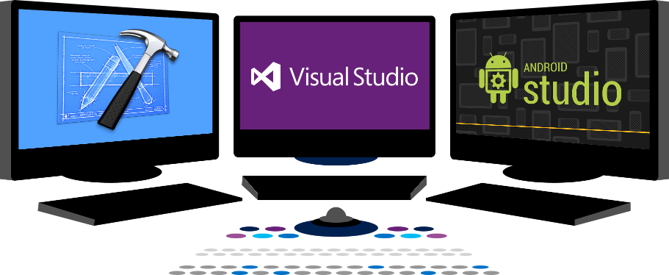














Vision
EXTEND OFFICE EVERYWHERE
CONNECT TO OFFICE 365 SERVICES
BUILD USING AN OPEN PLATFORM
Delve
z
Users and groups
Files
Mail
Calendar
My Apps
Video Portal
Contacts
Office Graph
Presentations
Documents
Spreadsheets
Lync
OneNote
Yammer

Slide 7
Introduction

Slide 8
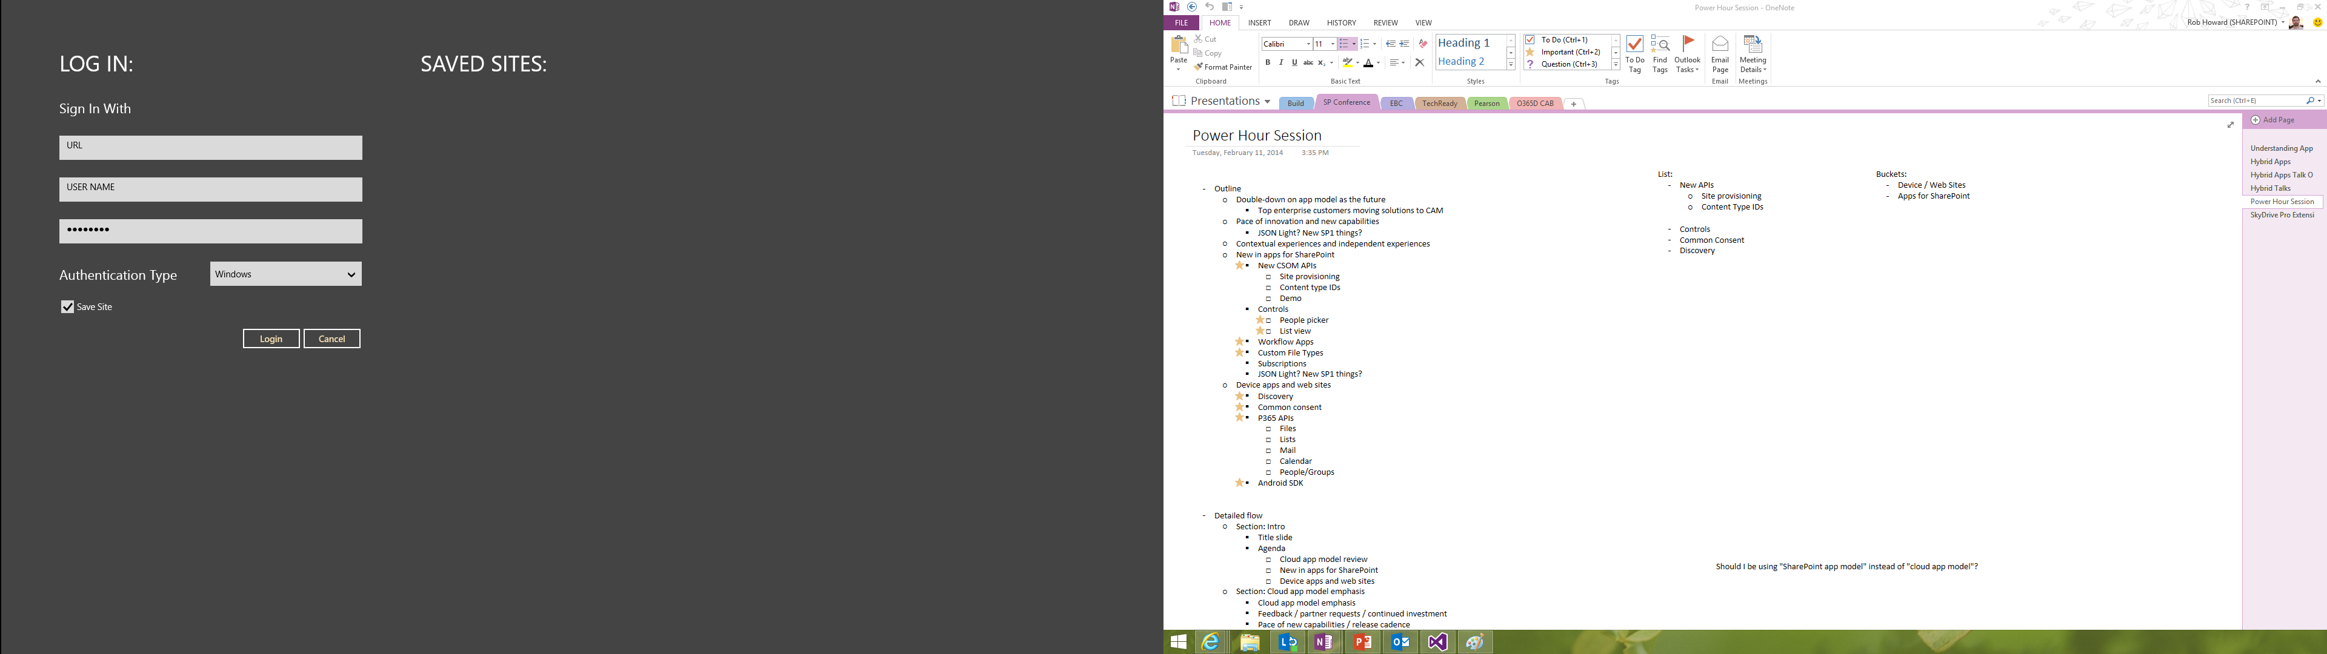
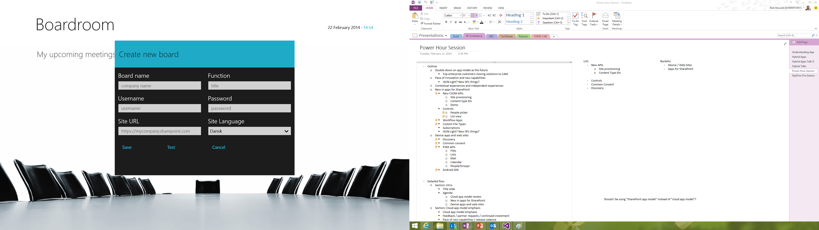
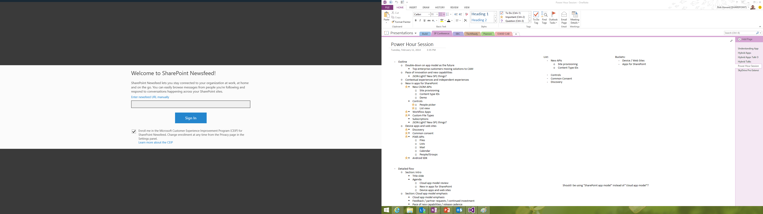
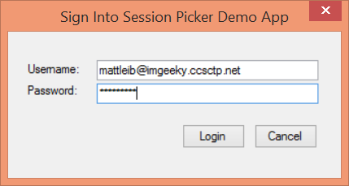
Office 365 Device Apps
Notes:
Prior to the release of the Office 365 APIs, device apps had to prompt users for credentials for the service, and in some cases the location of the resources.
Storing credentials is very risky, and a worst practice.

Slide 9
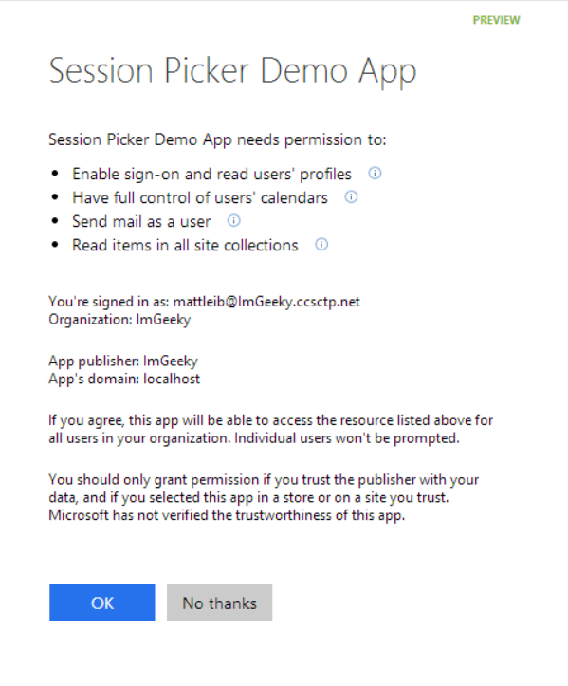
Azure AD OAuth in Office 365 Preview
Single auth flow for Office 365
Azure AD Graph, Exchange, SharePoint
Device apps and web sites
Admin and end-user consent
Secure protocol
OAuth 2.0
No capturing user credentials
Fine-grained access scopes
Supports MFA and federated user sign-in
Long-term access through refresh tokens
Notes:
With the Office 365 APIs, which leverage the Azure AD Oauth service, device apps no longer need to store user credentials.
Azure AD has implemented a “Common Consent” dialog, providing a consistent interface for permission grants.
Typically, OAuth is used to access a single resource. Common Consent is unique in that it can provide a token to Exchange Mail/Calendar/Contacts as well as SharePoint lists and files in OneDrive .

Slide 10
OAuth Basics and Authentication Flow

Slide 11
Authentication to Office 365 APIs using Resource Id
Azure AD Authorization
Endpoint
Azure AD Token
Endpoint
Native Application
Office 365 API
Request authorization code
Sign-in via browser pop-up
Return authorization code
Redeem authorization code and acquire access token for Office 365 resource
Return access token and refresh token
Call Office 365 API using the access token
Return Http Response
Notes:
** This slide has animations **
To facilitate the issuance of tokens for multiple resources, a different approach is required.
Instead of requesting an access token from the Authorization Endpoint, an authorization code is requested. The Resource Id for which a token is desired in included in the call to the Authorization Endpoint. The Authorization Endpoint will ensure the user is logged in, and will present the Common Consent dialog that lists the permissions requested by the application.
The authorization code is redeemed at the new Token Endpoint, which returns an access token and a refresh token. The token is issued for the resource identified in the authorization code request.
The access token is used to access the resource. The access token represents the user’s permissions to the resource. The application permission is granted during common consent.

Slide 12
demo
OAUTH AUTHENTICATION FLOW
Notes:
Using the browser and Fiddler, the authentication and token issuance flow can be demonstrated without writing code. Exercise 2 in the lab has detailed steps. (Exercise 1 is a pre-requisite.)

Slide 13
App Registration & Authentication

Slide 14
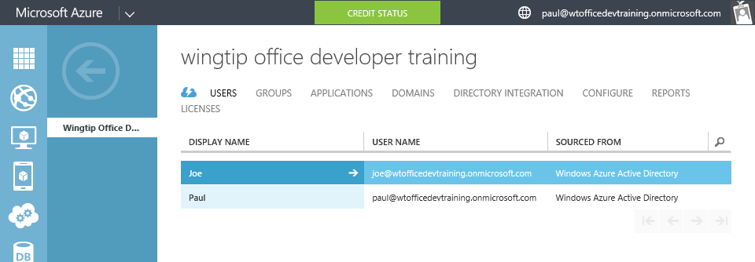
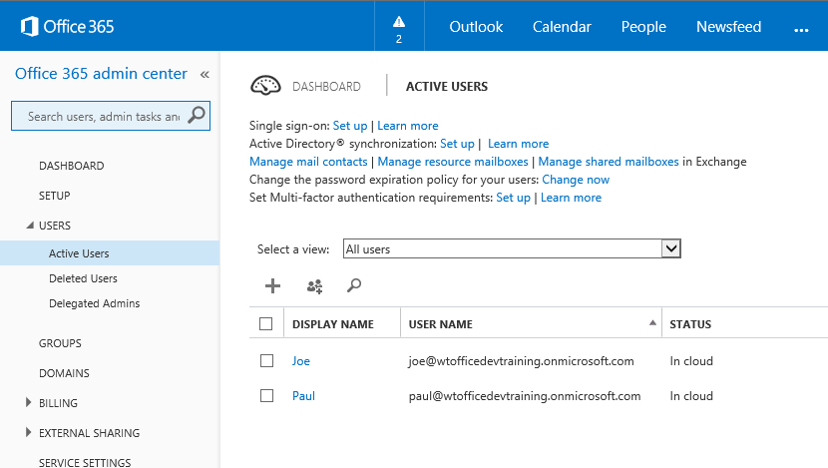
Azure Active Directory (Azure AD)
Included in Office 365 Subscription
Users & Groups managed in Office 365 Portal
Changes persisted in Azure AD
Notes:
Although an Azure AD is included with Office 365, accessing it via the Azure Management Portal requires a “sign-up.” However, there are no charges from Azure for using AD. (Charges will occur if other services are used.)

Slide 15
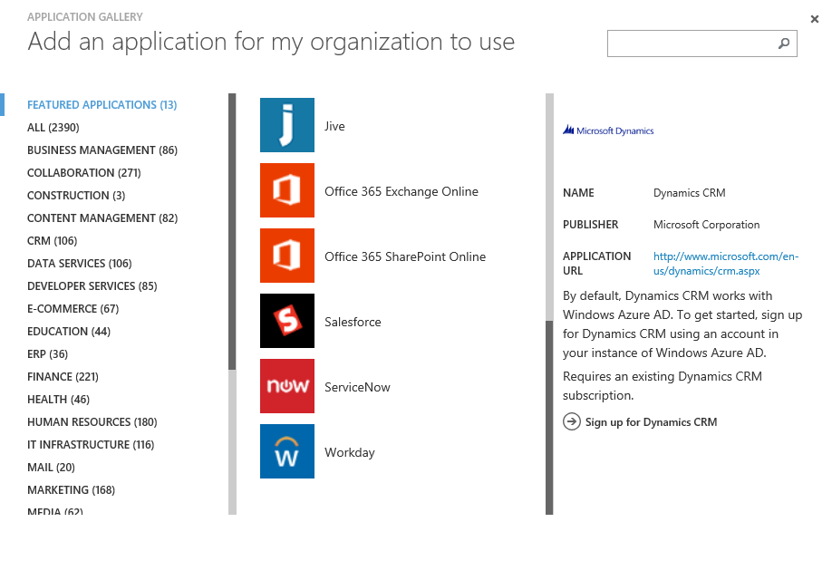
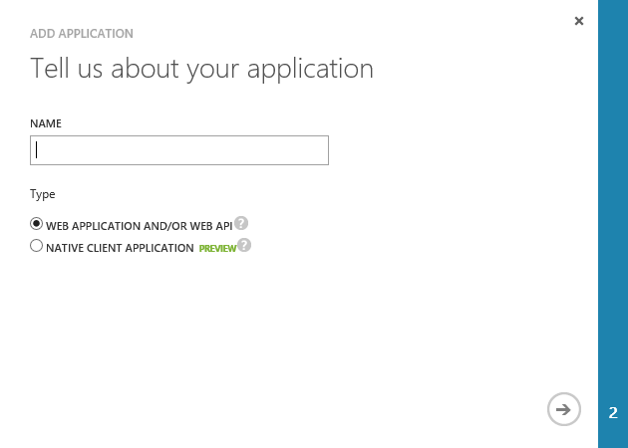
Application Registration
Application Types
Custom developed
Third-party, published in the gallery
Office 365 SharePoint, Exchange
Dynamics CRM
Thousands of others
Custom Applications
Web Application and/or WebAPI
Native Client

Slide 16
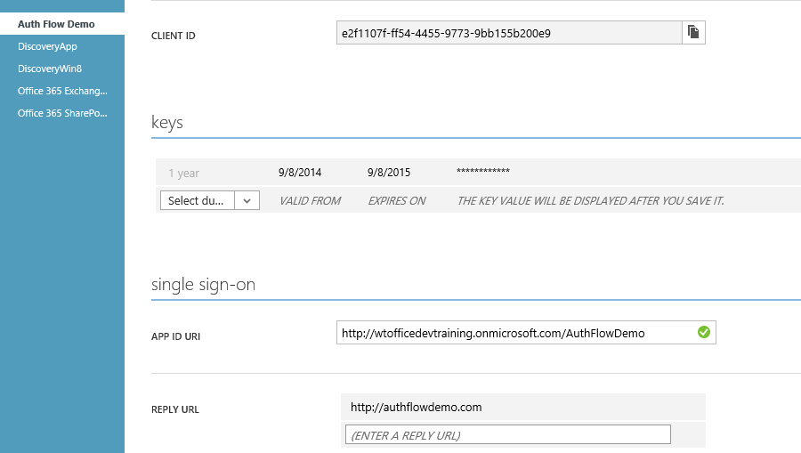
Custom Application Registration
Key information
Client ID
Keys (aka Client Secret)
Redirect /Sign-On URI

Slide 17
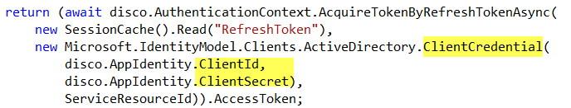
Application Authentication
App Authentication uses Client ID/Secret
Protect this information just as you would a user name / password
Notes:
In this snippet from Module 3653-4, notice the Client ID and Client Secret are used to create a credential object.

Slide 18
Office 365 Discovery Service

Slide 19
O365 Discovery Service
Returns a collection of endpoints specific to current user
Intended as the starting point for application
1. Sign-In
2. Get authorized
3. Discover endpoints for resource
4. Get Token
5. Access resource
API Libraries simplify necessary code

Slide 20
demo
OFFICE 365 DISCOVERY SERVICE
Notes:
The DiscoveryWin8 app demonstrates the results of the API steps. The App *does not* use the O365 libraries, rather uses raw calls to the endpoints. This demo is intended to show the underlying functionality rather than hide it behind the library.
Original demo is at http://code.msdn.microsoft.com/Office-365-APIs-How-to-use-609102ea
Demo is also in the Completed Projects folder

Slide 21
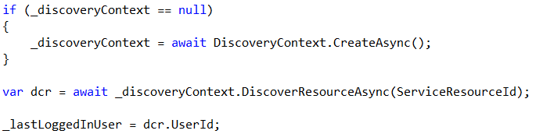
Office 365 API Libraries
How it works
Mail / Calendar / Contacts
Create a Discovery Context
Call DiscoverResourceAsync() method, passing a string that identifies the resource required
Returns the UserId and TenantId
* Does not return an endpoint, since this a static endpoint (https://outlook.office365.com) *
Notes:
This slide is a quick introduction to the libraries. Following modules explore these in depth.

Slide 22
Office 365 API Libraries
How it works
My Files / SharePoint Sites
Create a Discovery Context
Call DiscoverCapabilityAsync() method, passing a string that identifies the resource required
Returns the UserId, TenantId and Endpoint
Notes:
This slide is a quick introduction to the libraries. Following modules explore these in depth.

Slide 23
Troubleshooting

Slide 24
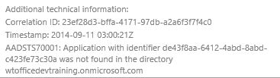
Troubleshooting Errors in Auth flow
Login Errors
Shown on web page
Fiddler
Shows response / request from apps running on local computer
Review Response as JSON
Authentication errors (invalid values)
{"error":"invalid_grant","error_description":"AADSTS70002: Error validating credentials. AADSTS50011: The reply address 'http://localhost:40298/Home/Discovery' is not valid.}

Slide 25
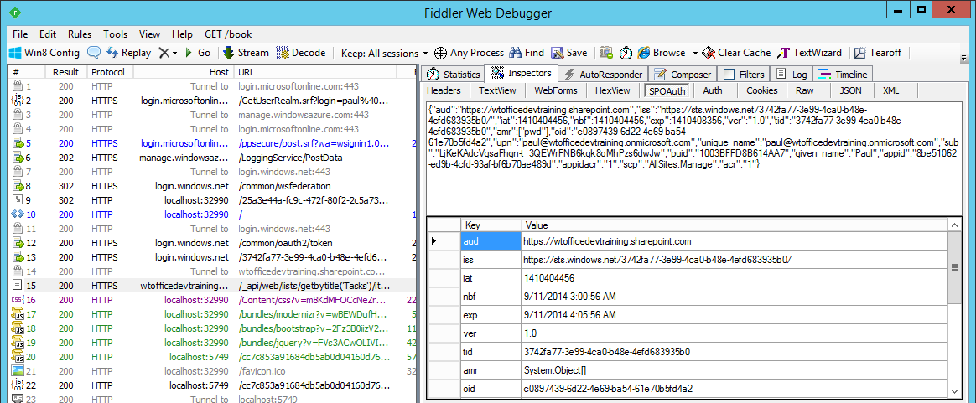
Troubleshooting Tokens
Fiddler
Extension to view SharePoint 2013 App Tokens
http://blogs.msdn.com/b/kaevans/archive/2013/08/25/creating-a-fiddler-extension-for-sharepoint-2013-app-tokens.aspx
Online
Paste token in web page
http://jwt.io/

Slide 26
Summary
Introduction
OAuth Basics & Authentication Flow
App Registration and Authentication
Office 365 Discovery Service

Slide 27



dev.office.com
Sign up
http://dev.office.com/getting-started
Explore
http://apisandbox.msdn.microsoft.com
Get trained http://dev.office.com/training

Slide 28


Feedback
Office 365 Network Share you best practices and join conversations https://www.yammer.com/itpronetwork
Stackoverflow Ask deep technical questions to a world-wide set of developers
http://stackoverflow.com/questions/tagged/ms-office
UserVoice Provide suggestions of what you want in future versions
http://officespdev.uservoice.com/

Slide 29

© 2014 Microsoft Corporation. All rights reserved. Microsoft, Windows, and other product names are or may be registered trademarks and/or trademarks in the U.S. and/or other countries.
The information herein is for informational purposes only and represents the current view of Microsoft Corporation as of the date of this presentation. Because Microsoft must respond to changing market conditions, it should not be interpreted to be a commitment on the part of Microsoft, and Microsoft cannot guarantee the accuracy of any information provided after the date of this presentation. MICROSOFT MAKES NO WARRANTIES, EXPRESS, IMPLIED OR STATUTORY, AS TO THE INFORMATION IN THIS PRESENTATION.

